Slide 1
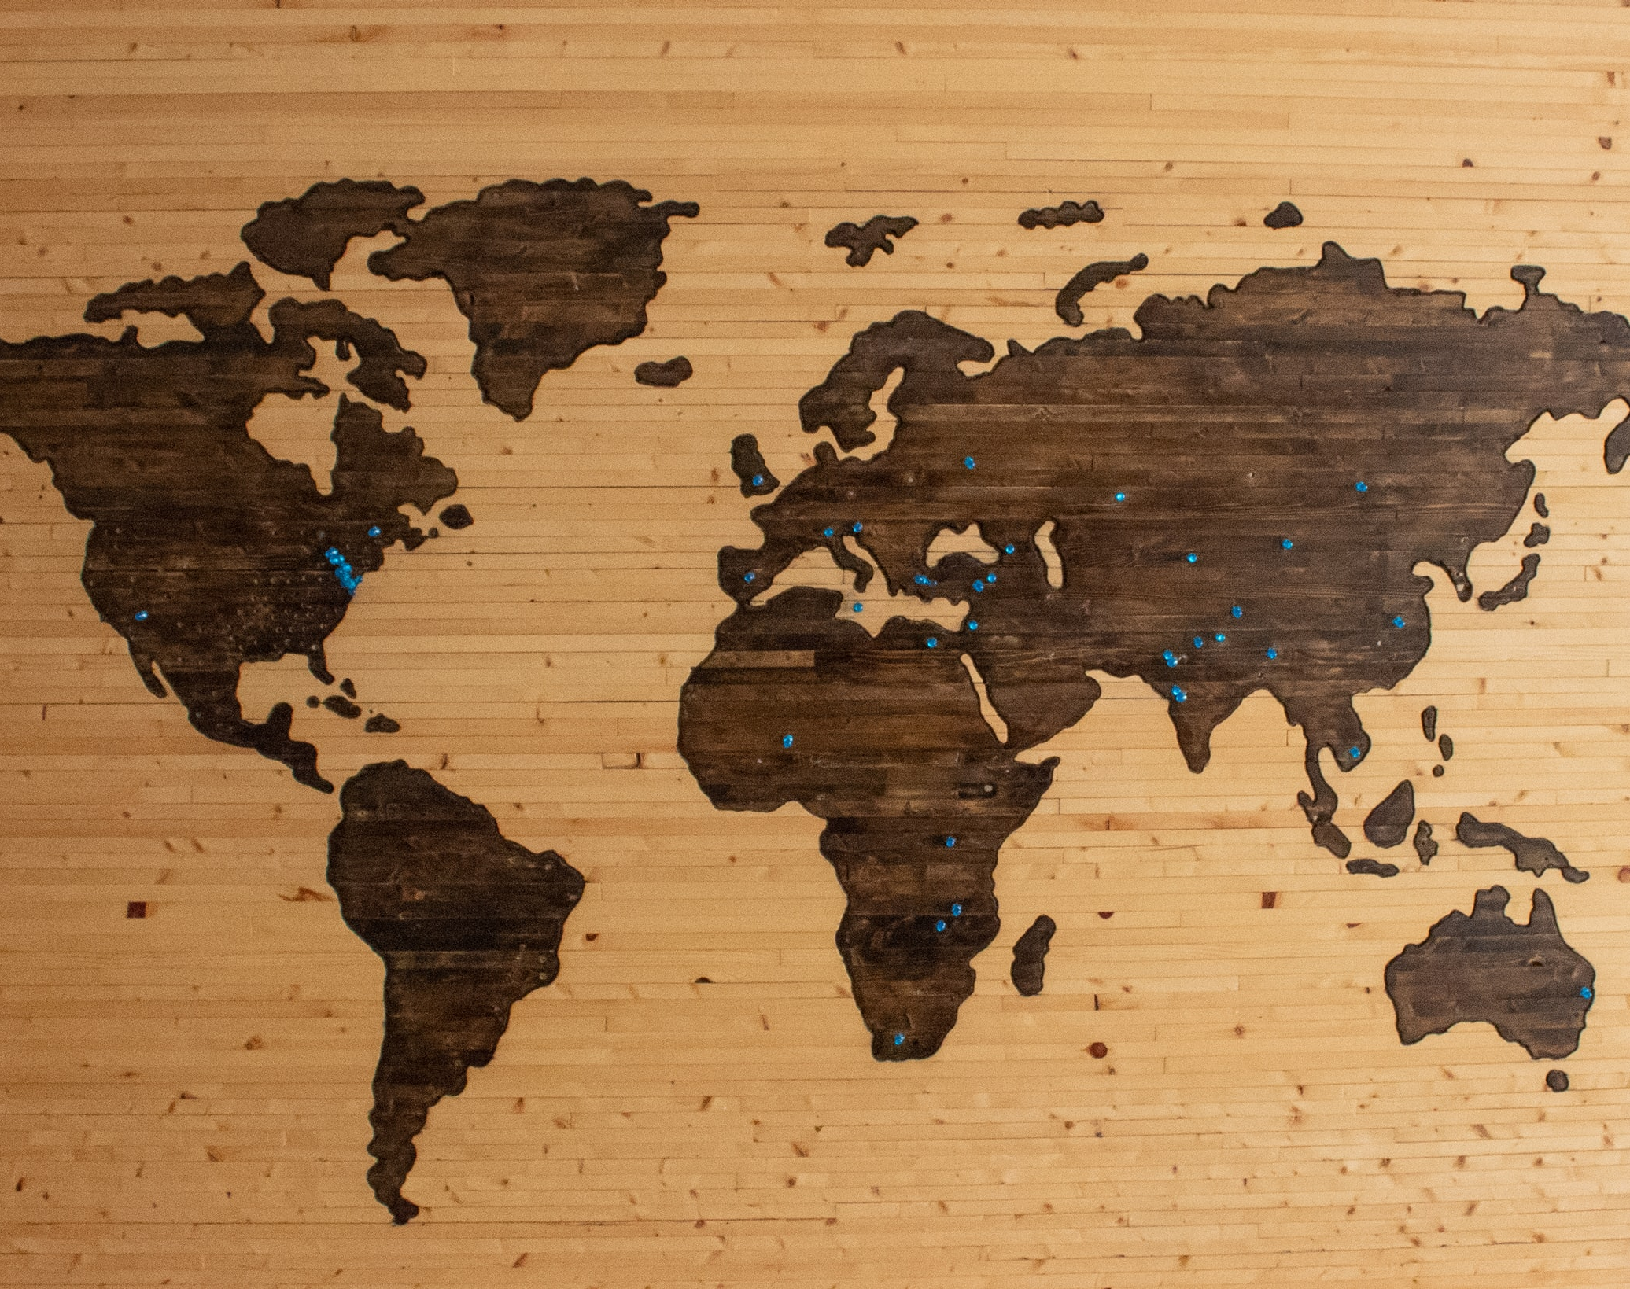
World GDP & Population Analysis Project
Led by: Adegbite,
Ayoade Abel

Slide 2
Web Scraping from GitHub Repo
Our data will be scraped from
this GitHub Page

Slide 3
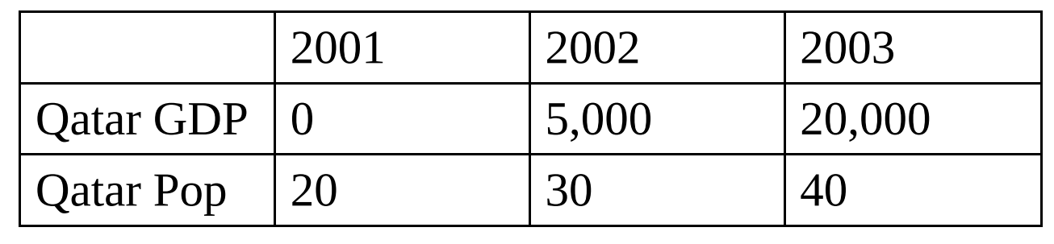
Calculated Fields
“Year Clean” calculated value which is equal to the first four characters of the existing Year dimension. You do this INT(LEFT([Year],4)) (we add the INT () function so it converts the string result “2019” to numeric 2019)
“GDP”, that checks if the Year value contains “.csv”.
The formula would : IF CONTAINS([Year], “.csv”) THEN [Combined] ELSE 0 END
So if the Year value does not contain “.csv”, then it’s a Population.
The formula would : IF NOT CONTAINS([Year], “.csv”) THEN [Combined] ELSE 0 END
“GDP per Capita”: SUM([GDP])/SUM([Population])
How this works: (20+30+40)/(0+5,000+20,000)= 277.7
“GDP per Capita Avg”: AVG({INCLUDE [Year Clean ]: [GDP per capita]})
How this works: 0/20+5,000/30+20,000/40= 666.6

Slide 4

THANK YOU

